Slide 1



A BLOCKCHAIN-BASED AI REPUTATION ENGINE FOR DECENTRALIZED CREDIT ASSESSMENT
DAIRE

Slide 2
PROJECT TEAM
TEAM MEMBERS
SUPERVISORS
  Amina Kalonge
  Atanasi Kafuka
  Amiri Athumani
  Anthony Athanas
  Eves Vitus
  John Nabwanda
  Jackson Bakari
  Francis Elias
  Noel Jackson
  Mkadam

Slide 3
TABLE OF CONTENT
  Introduction
  Problem Statement
  Main Objective
  Specific Objective
  Scope
  Benefits
  Conceptual Diagram
  Technology
  Project Timeline
  Conclusion
11.Questions And Answers

Slide 4
INTRODUCTION
DAIRE is reputation engine that is will help to provide credit scores for customers and groups. Example entrepreneurs, small groups of women and youth, farmers and peasant farmers.

Slide 5
PROBLEM STATEMENT
In Tanzania, small-scale farmers, youth, and women often struggle to access suitable loans due to limited credit information and the lack of accurate assessment of how much they can responsibly borrow. This limits their ability to sustain and grow their livelihoods, contributing to poverty and reduced national income.

Slide 6
MAIN OBJECTIVE
To develop Decentralized Ai Reputation Engine to provide credit score

Slide 7
SPECIFIC OBJECTIVES
  To calculate credit score
  To intergratelenders systems and blockchain
  To develop AI model for credit evaluation

Slide 8
SCOPE
Inside scope
Outside scope
1.Loan application and approval
2.Loan disbursement and repayment management
3.web3 ensure immutability of credit records
1.AI will not predict credit score
2.Debt collection and loan recovery services

Slide 9
BENEFITS
  It will help citizens to borrow a reasonable amount of which they can handle
  It wil help lenders and financial institution in giving loans accordingly to the users

Slide 10
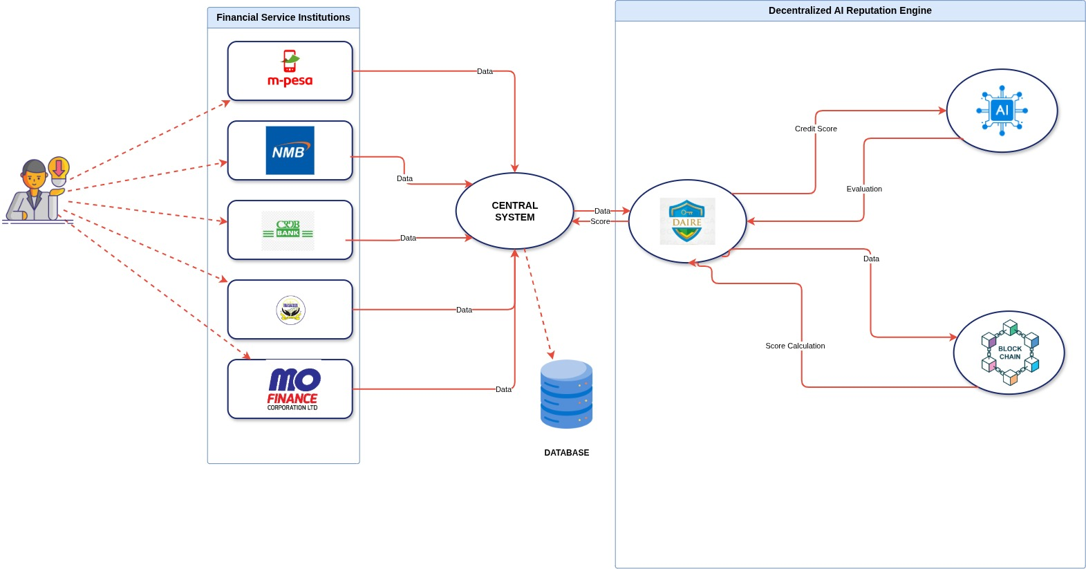
CONCEPTUAL DIAGRAM

Slide 11






TECHNOLOGY
Angular
Django
Python
Ethereum
Postgresql
Solidity

Slide 12
CONLUSION
Combining AI precision with Web3 blockchain immutability ensures a transparent, decentralized, and tamper-proof reputation system.

Slide 13
THANK YOU

Slide 14
QUESTIONS AND ANSWERS

